Slide 1
RATINGS PREDICTION

Slide 2
RATINGS PREDICTION
client who has a website where people write different reviews for technical products
they want to predict ratings for the reviews which were written in the past and they don’t have a rating
we have to build an application which can predict the rating by seeing the review

Slide 3
Data Collection Phase
section you need to scrape the reviews of different laptops, Phones, Headphones, smart watches, Professional Cameras, Printers, Monitors, Home theater, Router
Basically, we need these columns
1) reviews of the product.
2) rating of the product.

Slide 4
Web Scraping script
Importing libraries
Import selenium web driver
Importing required Exceptions which needs to handled
Importing requests

Slide 5
Activating the chrome browser
Opening
Opening the homepage of Amazon.in
Asking
Asking the user to input the keywords he/she wants to search

Slide 6
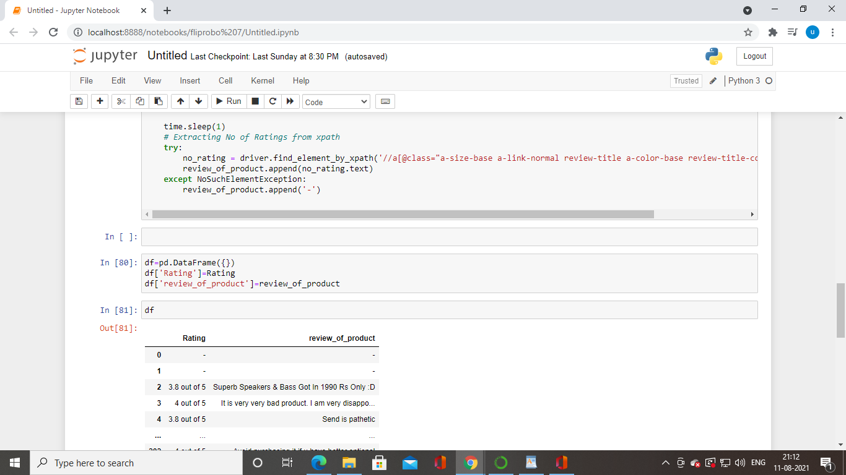
Data frame of webscraping

Slide 7
Machine learning
Import library methods
Reading csv file
Checking the shape
Drop the columns unamed:0
Df.describe() method is used find out the mean ,standard deviation

Slide 8
Visualizing the ratings
4.1 which has the highest value of count is 140 count
4.9 which has the low value 1

Slide 9
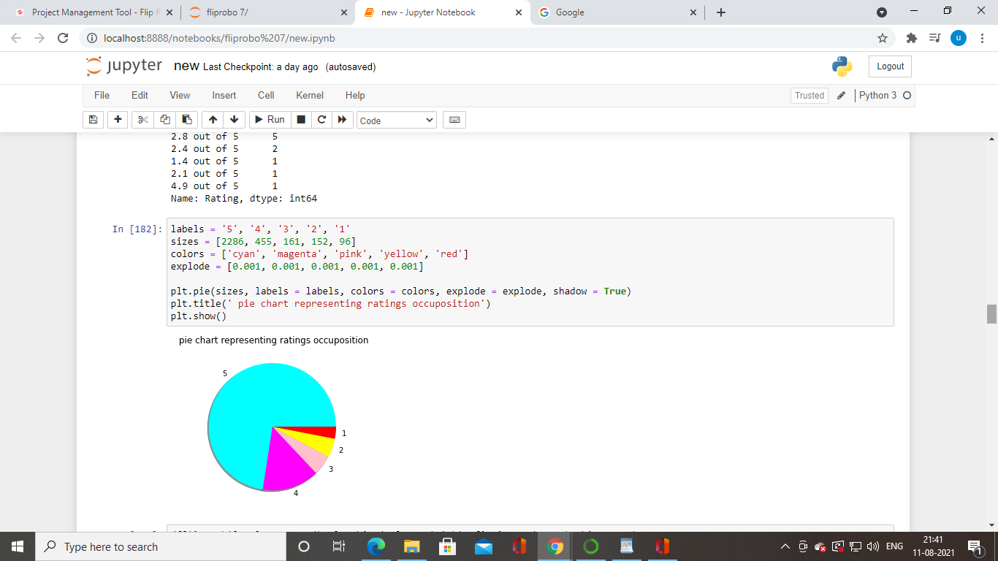
rating

Slide 10
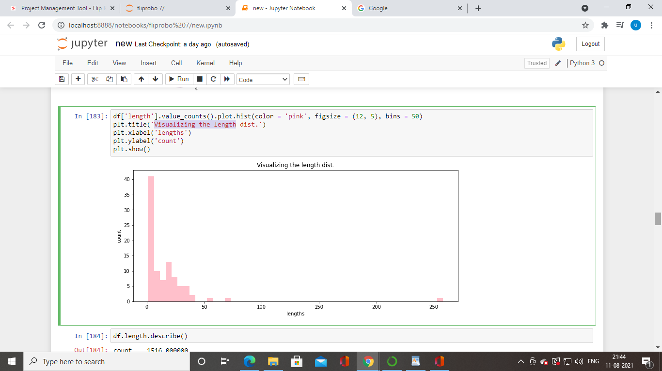
Visualizing the length

Slide 11
countvectorizer
CountVectorizer is a great tool provided by the scikit-learn library in Python. It is used to transform a given text into a vector on the basis of the frequency (count) of each word that occurs in the entire text. .

Slide 12
Word clouds
Word clouds or tag clouds are graphical representations of word frequency that give greater prominence to words that appear more frequently in a source text. The larger the word in the visual the more common the word was in the document(s)

Slide 13
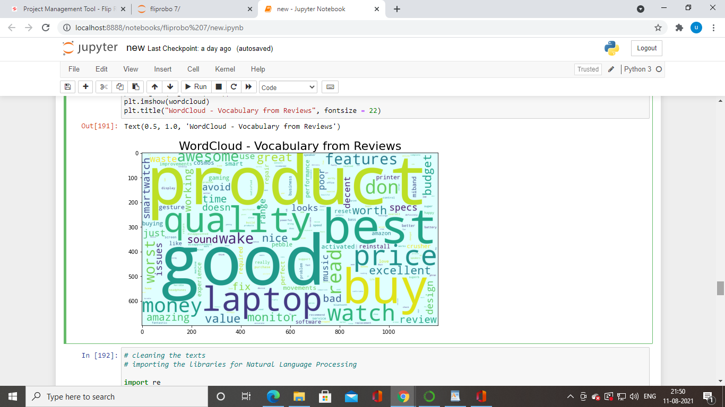

Slide 14
cleaning the texts
importing the libraries for Natural Language Processing
creating bag of words

Slide 15
Random forest
Random forests or random decision forests are an ensemble learning method for classification, regression and other tasks that operates by constructing a multitude of decision trees at training time. For classification tasks, the output of the random forest is the class selected by most trees

Slide 16
Random forests
Training Accuracy : 0.943449575871819 Testing Accuracy : 0.4901098901098901 [[76 0 0 ... 0 0 0] [ 1 0 0 ... 0 0 0] [ 5 0 2 ... 0 0 0] ... [ 0 0 0 ... 0 0 0] [ 0 0 0 ... 0 0 0] [ 0 0 0 ... 0 0 0]]

Slide 17
cross validation
Cross-validation,^{[2][3][4]} sometimes called rotation estimation^{[5][6][7]} or out-of-sample testing, is any of various similar model validation techniques for assessing how the results of a statistical analysis will generalize to an independent data set. It is mainly used in settings where the goal is prediction, and one wants to estimate how accurately a predictive model will perform in practice

Slide 18
cross validation
Accuracy : 0.48732146005995414 Standard Variance : 0.03380501071881276

Slide 19
GridSearchCV
GridSearchCV is a library function that is a member of sklearn's model_selection package. It helps to loop through predefined hyperparameters and fit your estimator (model) on your training set

Slide 20
GridSearchCV
Mean Cross Validation Accuracy - Train Set : 88.04267491027964 Mean Cross Validation Accuracy - Validation Set : 40.61125324236933 Accuracy Score for Test Set : 0.4901098901098901

Slide 21
DecisionTreeClassifier
The decision tree classifier (Pang-Ning et al., 2006) creates the classification model by building a decision tree. Each node in the tree specifies a test on an attribute, each branch descending from that node corresponds to one of the possible values for that attribute

Slide 22
DecisionTreeClassifier
Training Accuracy : 0.943449575871819 Testing Accuracy : 0.4967032967032967 [[76 0 0 ... 0 0 0] [ 1 0 0 ... 0 0 0] [ 5 0 2 ... 0 0 0] ... [ 0 0 0 ... 0 0 0] [ 0 0 0 ... 0 0 0] [ 0 0 0 ... 0 0 0]]

Slide 23
Best model is Random forests classifier

